Slide 1
Azure Active Directory for non-developers
Rory Braybrook
@rbrayb

Slide 2
For cloud authentication, Azure Active Directory has you covered

Slide 3
Overview
AAD
ACS
Graph
Explorer
ADAL
PIM
Access Panel
Protocols

Slide 4
Azure AD by the Numbers
86%
of Fortune 500 companies on Microsoft Cloud (Azure, O365, CRM Online and PowerBI)
Azure AD manages identity data for
>5 M organizations
More than
500 M objects hosted on Azure Active Directory
1 Trillion
Azure AD authentications since the release of the service
50 M Office 365 users active every month
>1 Billion authentications every day on Azure AD
Every Office 365 and Microsoft Azure customer uses Azure Active directory

Slide 5
Statistics
Over 2.9 Million Organizations are using Azure Active Directory
More than 10 Billion Authentications per week
Azure Active Directory is spread out across 14 data centers
Contains more than 240 million user accounts
Organizations using Azure Active Directory across 127 countries
Supports over 1400 integrated third-party apps

Slide 6
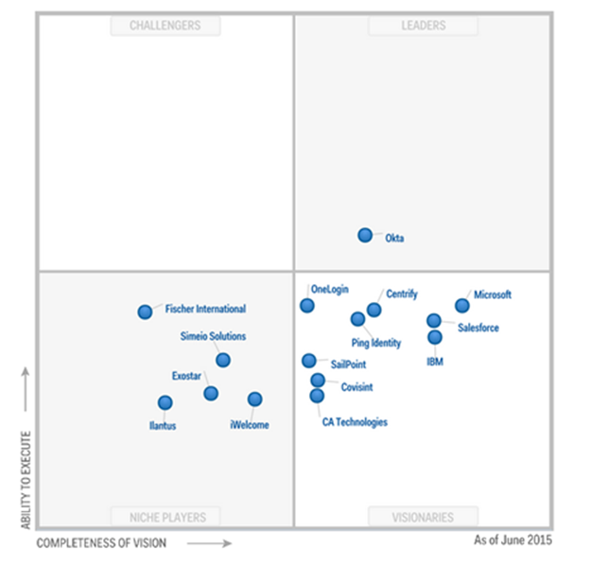
Gartner Magic Quadrant

Slide 7
AAD vs AD

Slide 8
AAD ≠
AD
in cloud
ADD ≠ AD in Azure VM
AD / ADFS AAD

Slide 9
AD
AD Domain Services
AD Lightweight Directory Services
AD Federation Services
AD Certificate Services
AD Rights Management Services
Corporate environment
Kerberos, LDAP, DNS
AAD
Azure Active Directory
Azure ACS / AAD
AD RMS
Cloud
REST, SAML-P, WS-Fed, OpenID Connect, OAuth, Graph API

Slide 10
AAD – one size fits all
Large companies
Projection of
on premises AD
Small companies
Main repository

Slide 11
Users
Attributes
AAD
targets
Authn / Authz

Slide 12
Printers
AAD
doesn’t support
Management
of devices
Group policy

Slide 13
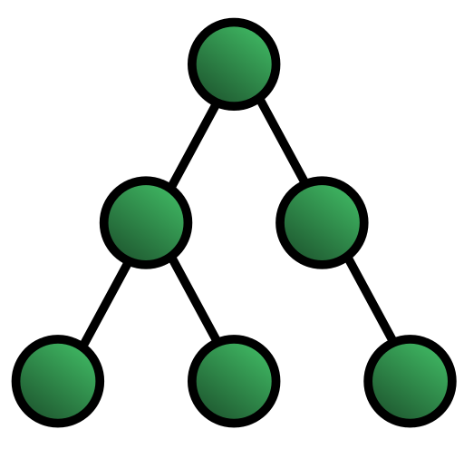


AD is hierarchical
Based on
Use
C# API

Slide 14

AAD is not hierarchical
Based on
Graph Theory
Use
Graph API based on REST

Slide 15
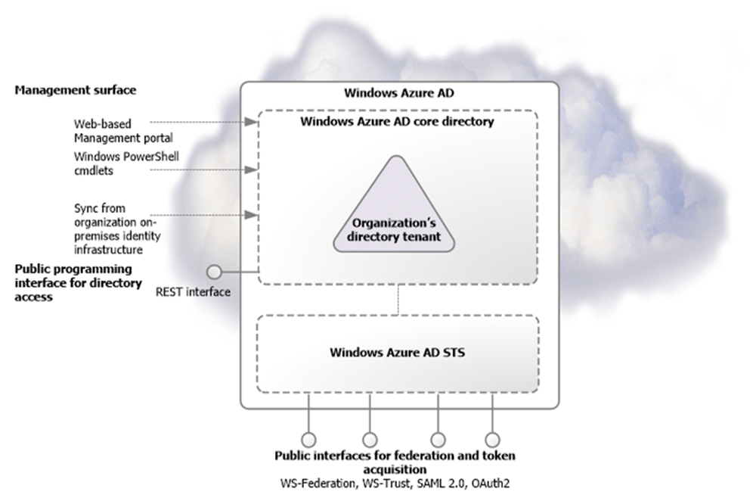
From: Microsoft – Active Directory from on-premises to the cloud

Slide 16
The Editions

Slide 17
Azure Active Directory Editions
Free - Part of every Azure subscription. There is nothing to license and nothing to install.
With it, you can manage user accounts, DirSync, SSO, SaaS applications. Will always be free.
Basic - Azure Active Directory Basic edition provides application access and self-service
identity management. Group-based access management, self-service password reset
for cloud applications, Azure Active Directory application proxy, customizable environment
for launching enterprise and consumer cloud applications. Premium - https://msdn.microsoft.com/en-us/library/azure/dn532272.aspx

Slide 18
Azure Active Directory Premium
Self-Service password reset with on-premises write-back
Self-Service group management
Microsoft Identity Manager (MIM) user licenses
Multi-Factor authentication
Customized company branding
Rich security monitoring, analytics, alerts and reporting
Cloud App Discovery and AAD Connect Health

Slide 19
The Protocols

Slide 20
Protocols
WS Federation
SAML-P 2.0
OAuth2
OpenID Connect

Slide 21
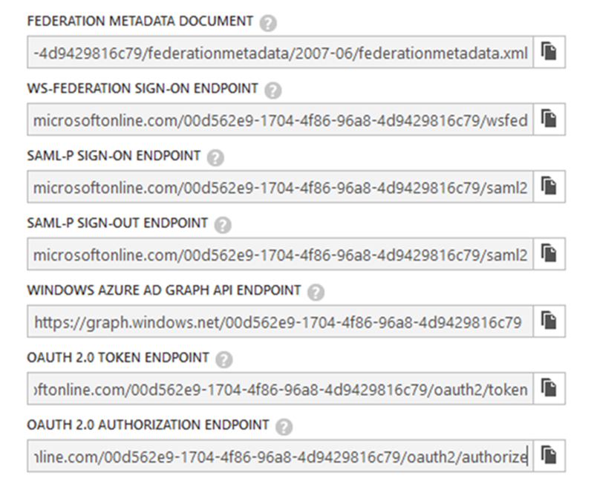

Slide 22
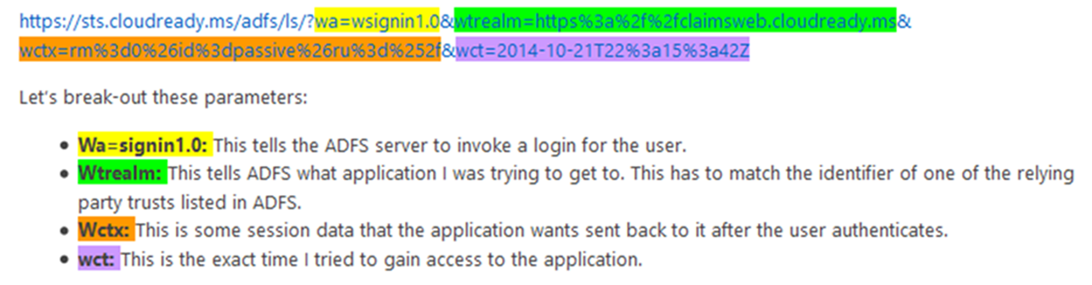
WS Federation

Slide 23
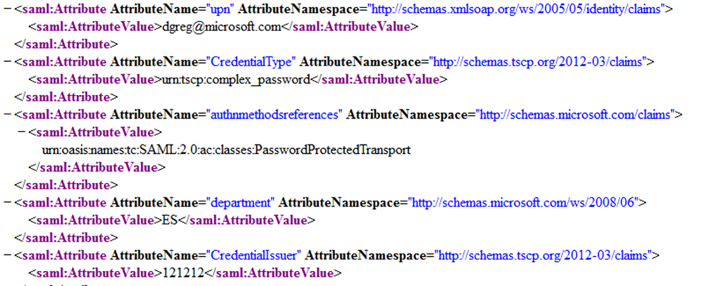
SAML Token Attributes

Slide 24
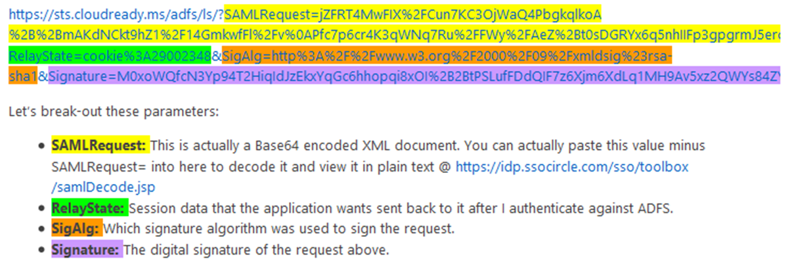
SAML-P

Slide 25
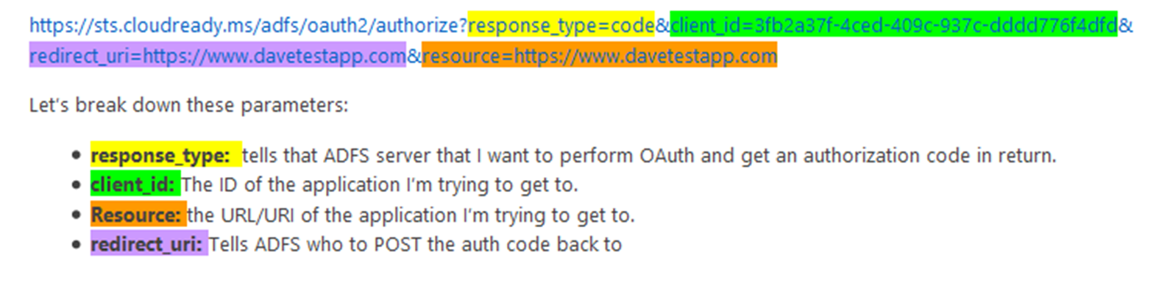
OAuth2
The hotel room cleaner!

Slide 26
OAuth2 Token

Slide 27
Use Cases

Slide 28



Authentication Scenarios
Browser
Web application
Web API
js
Native app
Web API
Web API
Server app
Clients using wide variety of devices/languages/platforms
Server applications using wide variety of platforms/languages

Slide 29
Authentication Scenarios
WS-Fed, SAML 2.0, OpenID Connect
Web application
OAuth 2.0
Web API
Browser
js
Native app
OAuth 2.0
OAuth 2.0
Web API
Web API
Server app
OAuth 2.0
OAuth 2.0
Standard-based, http-based protocols for maximum platform reach

Slide 30
Graph Explorer
https://graphexplorer.cloudapp.net/

Slide 31
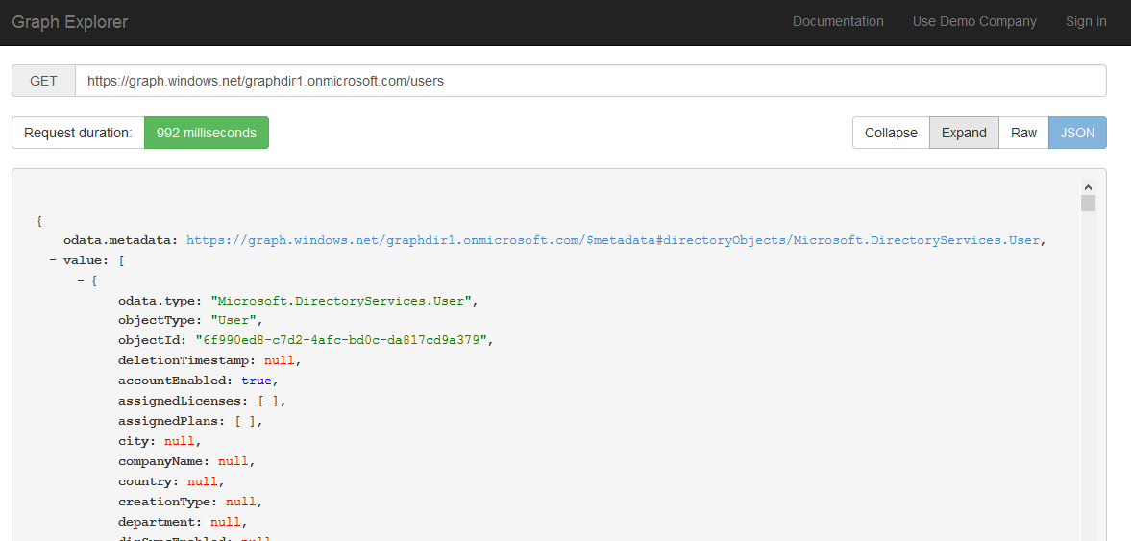

Slide 32
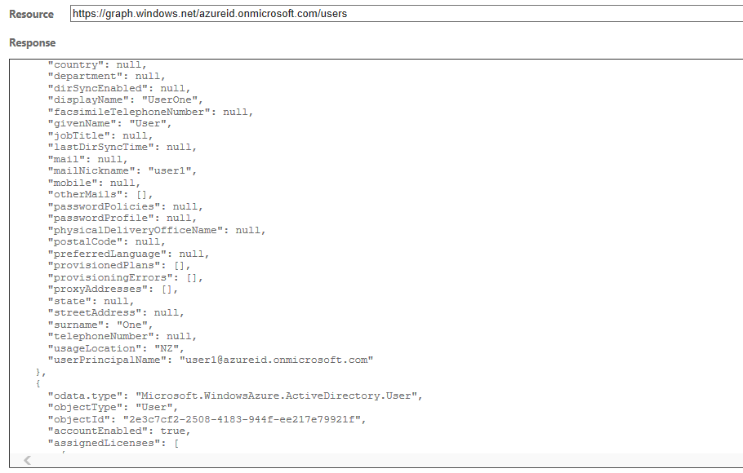

Slide 33
Extending the Schema
Use “Extension” properties
Must be either String or Binary
Cannot exceed 256 bytes
Can only extend some schemas e.g. Users, Groups, Device, Application etc.
Each tenant can only have 100 extensions

Slide 34
Lap around the AAD Portal

Slide 35
The Access Panel
https://myapps.microsoft.com/

Slide 36
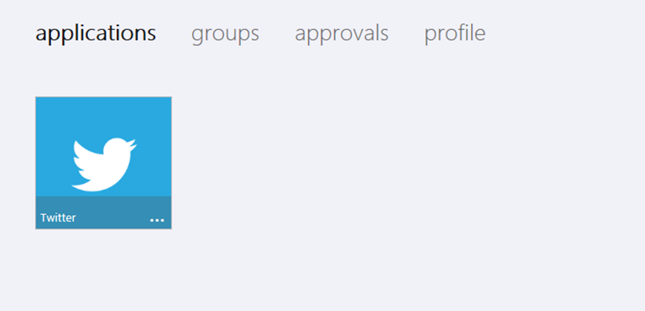
myapps

Slide 37
Access Control Services (ACS)

Slide 38
ACS
Under “Access Control Namespaces”
Future uncertain – will be absorbed into AAD
Allows social logins – Windows Live, Facebook, Google, Yahoo

Slide 39
Administrative Units

Slide 40
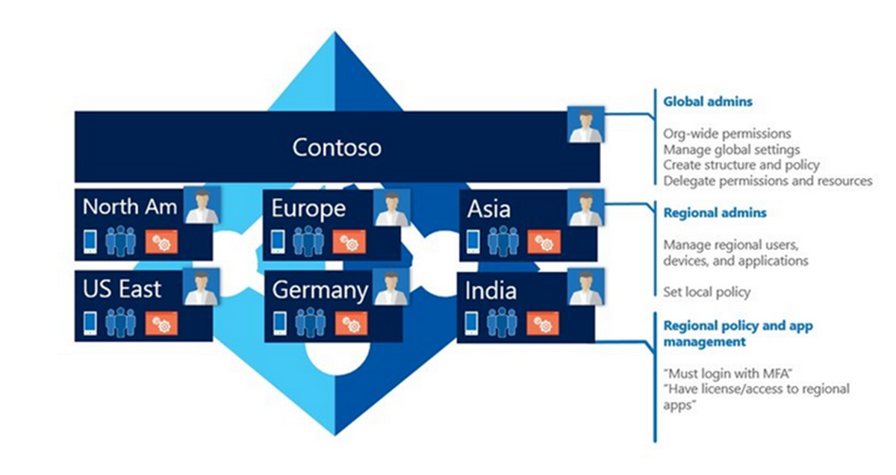

Slide 41
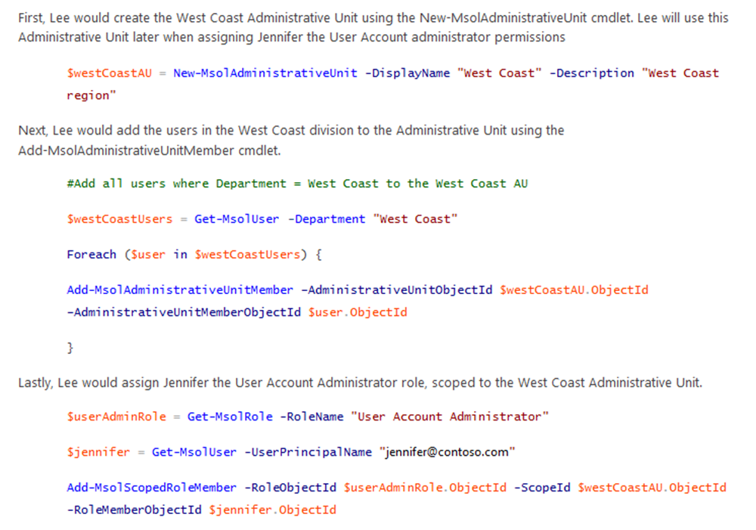

Slide 42
Privileged Identity Management

Slide 43
Privileged Identity Management
Securely managing access to privileged accounts has been a challenge
Help you discover the Azure Active Directory privileged administrator roles
Enable you to revoke permanent privileged access and provide a mechanism that manages on-demand, time-limited access for Azure Active Directory privileged accounts
“Just in time administration” functionality .
Auditing via store in preview portal

Slide 44
Active Directory Authentication Library

Slide 45
Active Directory Authentication Library (ADAL)
Available on multiple platforms
.NET, iOS, Javascript, Android, Node.JS, Java, Windows Store etc.
Now open source
Works on premises (ADFS 2012 R2) and cloud (Azure Active Directory)
ADFS only supports OAuth2 authorisation code grant
Cache and automatic refresh
Multi-user support

Slide 46
Advanced Security Monitoring Benefits

Slide 47
Detect: Brute Force Attack
1: <qwrsd!@@#> Nah! Didn’t work
2: <sdsaswer> Nah! Didn’t work
3: <34sdfs> Nah! Didn’t work
4: <sdsaswer> Nah! Didn’t work
5: <asas> Nah! Didn’t work
6: <qwrsd!@@#> Nah! Didn’t work
7: <sdsaswer> Nah! Didn’t work
8: <34sdfs> Nah! Didn’t work
9: <sdsaswer> Nah! Didn’t work
10: <asas> Nah! Didn’t work
……………………………………
……………………………………….
………………………………………….
……………………………………..
…………………………………..
78: <Password>Aha!!!!! That worked! Duh!
Signal if appears attacker has brute forced user’s password

Slide 48
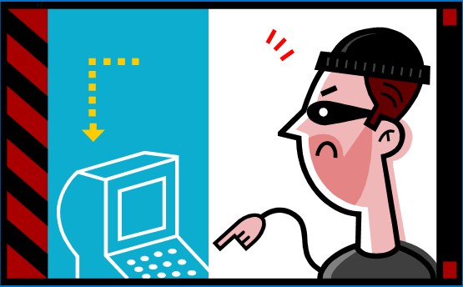
Detect: Sign In From Anonymizer Network
IP Address:
31.172.30.4
IP address: 199.34.28.10
TOR Network
Signal if requests originate from anonymizer network

Slide 49


Detect: Unlikely Travel
Joe@Contoso.com
Location: Somewhere in Asia
Time: 7:54 AM, local time
(3:54 PM, UTC)
Joe@Contoso.com
Location: Seattle, WA
Time: 8:29 AM, PST
(3:29 PM, UTC)
Signal if user signs in from locations distant from each other in short time period

Slide 50
Detect: Anomalous Activity Spanning Tenants
X Bad password
X Bad username
X Bad password
X Bad username
X Bad password
IP Address: 199.34.28.10
X Bad username
X Bad username
X Bad password
Signal if multiple failed requests from single IP to many tenants

Slide 51
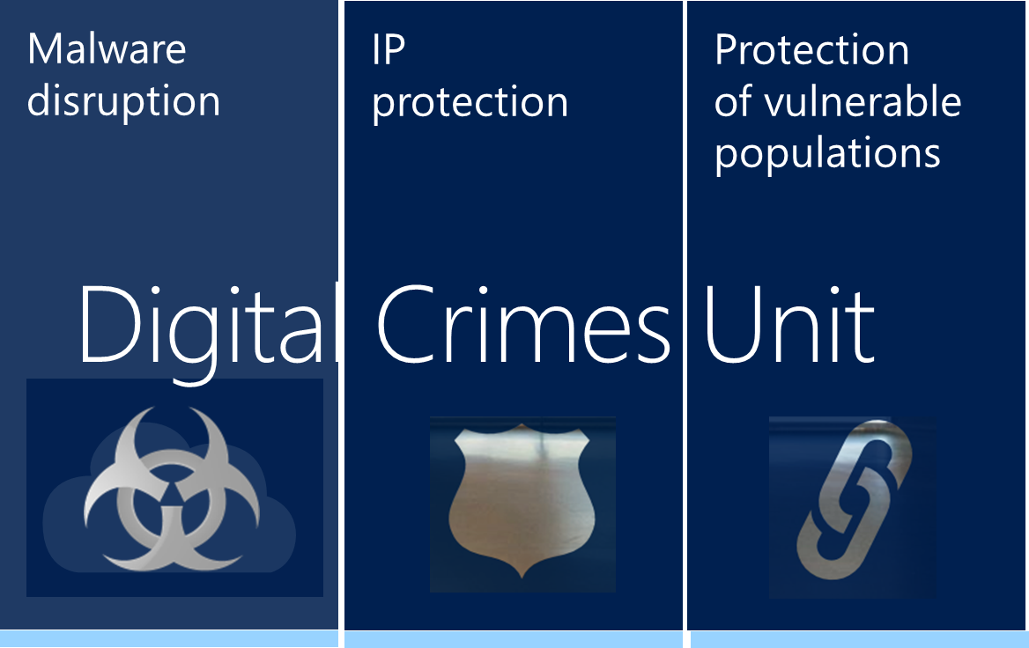


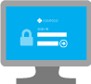

Detect: Sign In From Known Infected Device
Botnet control center
IP = 199.34.28.10
IP = 199.34.28.10
Signal if requests from known infected devices

Slide 52
AAD Application Proxy

Slide 53
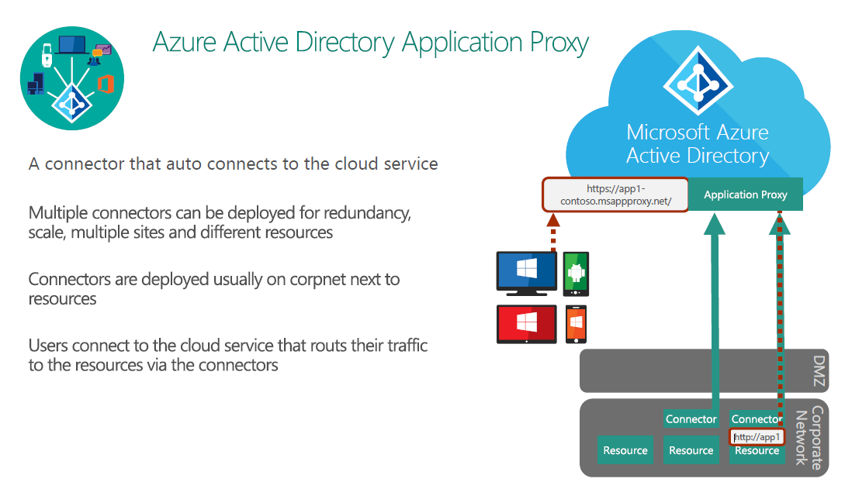
AAD Proxy

Slide 54
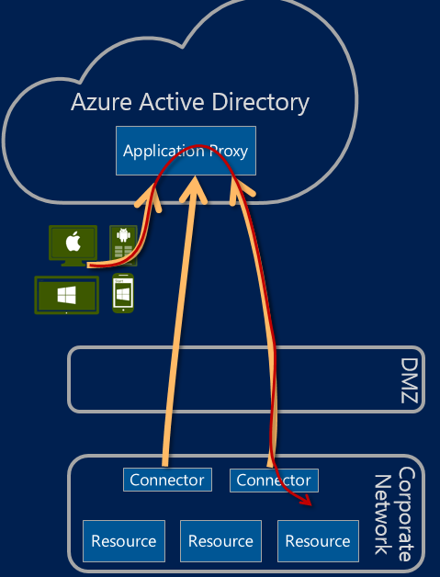
Azure Active Directory Application Proxy
Extends WAP – Server 2012 R2
Part of AAD Premium
Ability to manage access to internal browser based applications (SharePoint Sites, Outlook Web Access and IIS based applications) using Azure AD
Need to install a light weight software agent on premises (AKA "connector“)
Uses relays

Slide 55
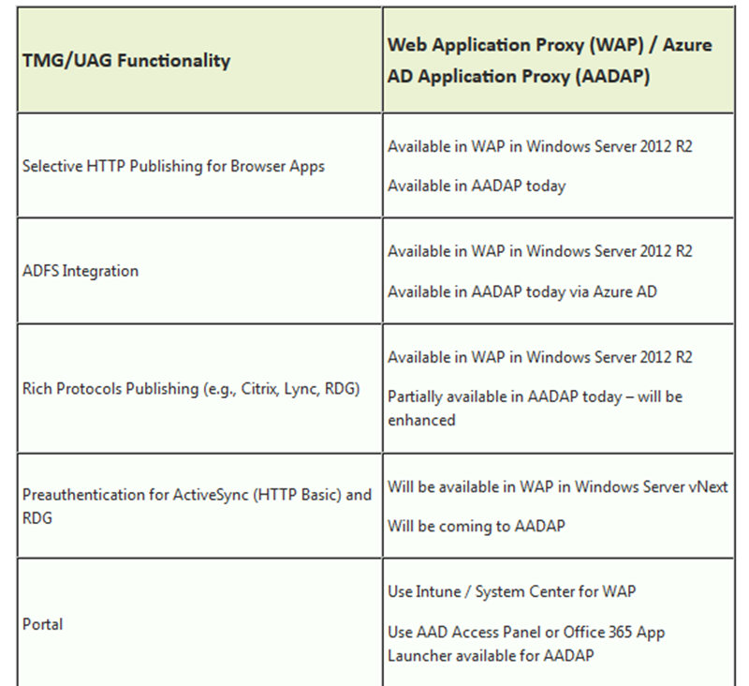
Proxy – UAG / TMG

Slide 56
Cloud App Discovery
Get a summary view of total number of cloud applications in use and the number of users using cloud applications
See the top cloud applications in use and top applications per category within the organization
See usage graphs for applications that can be pivoted on users, requests or volume of data exchanged with the application
Drill down into specific applications for targeted information
Easily proceed to integrate an application with Azure Active Directory
Requires an agent to discover the applications in use. Deployed on all machines in your organization that run Windows 7 or higher versions. These agents capture app usage information and send it over a secure, encrypted channel to the Cloud App Discovery service

Slide 57
Windows 10
Universal Applications – Web Application Manager
Windows 7 / 8 / 8.1 – ADAL – Web Application Broker
ADAL still works on Windows 10

Slide 58
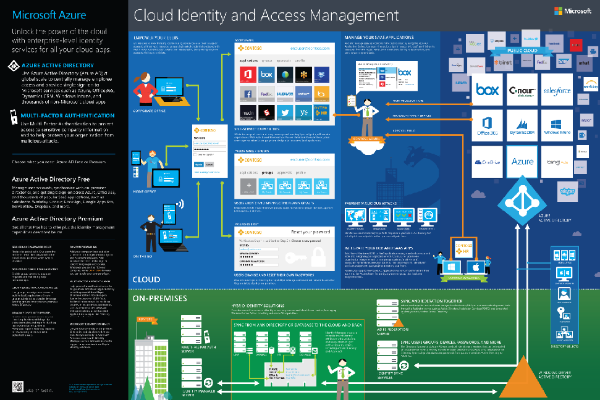
https://identity-test.datacomcc.com/Account/SignIn?ReturnUrl=/issue/wsfed?wa=wsignin1.0&wtrealm=http://dslfimad.dslfim.local/adfs/services/trust&wctx=00cacd9f-0aae-434a-b057-f1bfc0d5f1f3&wct=2014-08-12T20:31:58Z

Slide 59
For cloud authentication, Azure Active Directory has you covered

Slide 60
References
Ask PFE - http://blogs.technet.com/b/askpfeplat/
Azure Active Directory: Identity Management as a Service for Modern Applications
- https://channel9.msdn.com/Events/Build/2015/2-738
Azure Active Directory - https://www.sovelto.fi/application/files/5014/2202/0991/Mika_Seitsonen_AzureAD_seminaari_20150123.pdf
Transitioning to Application Proxy from UAG and TMG -
http://blogs.technet.com/b/applicationproxyblog/archive/2015/07/02/transitioning-to-application-proxy-from-uag-and-tmg.aspx

Slide 61
Resources
Azure blog - http://azure.microsoft.com/blog/
Ask Premier Field Engineering - http://blogs.technet.com/b/askpfeplat/
Active Directory Team blog - http://blogs.technet.com/b/ad/
.Cloud Identity Infographic - http://azure.microsoft.com/en-us/documentation/infographics/cloud-identity-and-access/

Slide 62
Azure Active Directory for non-developers
Rory Braybrook
@rbrayb

Slide 63
Question:
Given that Office 365 is essentially Azure SaaS and ignoring licensing issues, how many ways are there to provision users in Office 365?
You need to enumerate them!

Slide 64
Answer:
Office 365 portal
AAD portal
PowerShell – New-MsolUser
Graph API
AD synch. (FIM / DirSync / AAD Sync etc.)
Any more?
Azure Management API doesn’t seem to have this functionality

Slide 65
